Slide 1
L02
AI Game Development & Computer Science Summer Program
Lecture 2: Expressions, Values, and Types
L02 | Expressions, Values, and Types
XL Academy x Aetheras.io
Notes:
Agenda:
- Evaluate an expression step by step.
- Name a value with a clear type.
- Use a type error as feedback.
Goals:
- A small score calculator.
- We trace values before running it.
- Then we add one edge case.

Slide 2
Today's agenda
Use this to track the plan and goals for the session.
Agenda
Goals
Evaluate an expression step by step.
Name a value with a clear type.
Use a type error as feedback.
A small score calculator.
We trace values before running it.
Then we add one edge case.
L02 | Expressions, Values, and Types
XL Academy x Aetheras.io

Slide 3
From abstraction to expressions
Last time we hid details. Today we make tiny ideas precise.
Abstraction
Expression
Type
Choose what matters.
Name the idea.
Hide the rest.
A piece of code that produces a value.
Example: 3 + 4.
Result: 7.
The kind of value.
Example: number, string, boolean.
Types catch bad assumptions.
Question: what value does this expression produce, and what kind of value is it?
L02 | Expressions, Values, and Types
XL Academy x Aetheras.io

Slide 4
Source note
This lesson adapts selected public computing ideas for this course.
What is reused
Course focus
Functions as input-to-output rules.
Domain and range language.
Values can have different representations.
Examples are now TypeScript based.
Original course logistics are removed.
AI is used as a careful helper.
Source note: adapted from public computing course materials and rewritten for this program.
L02 | Expressions, Values, and Types
XL Academy x Aetheras.io

Slide 5
Expressions evaluate to values
Evaluate means: reduce the expression until one value remains.
3 + 4 * 2
3 + 8
11
Trace rule
Do one operation at a time.
Keep the value after each step.
Say the type out loud.
Why it matters
Computers do exactly what the expression says.
Tracing helps you find wrong assumptions before they become bugs.
L02 | Expressions, Values, and Types
XL Academy x Aetheras.io

Slide 6
Values have types
A type tells us what operations make sense.
number
string
boolean
Example: 42
Useful for: add, compare, round
Example: "score"
Useful for: join, slice, measure
Example: true
Useful for: choose, guard, test
A type is a promise about what the value can do.
L02 | Expressions, Values, and Types
XL Academy x Aetheras.io

Slide 7
Names make values reusable
A name lets you reuse a value without repeating the whole expression.
const baseScore = 40;
const bonus = 8;
const total = baseScore + bonus;
`const` first
Use `const` when a value should not change.
This makes your program easier to trust.
Trace it
baseScore is 40.
bonus is 8.
total is 48.
L02 | Expressions, Values, and Types
XL Academy x Aetheras.io

Slide 8
TypeScript can infer types
Inference means TypeScript can often figure out the type from the value.
const points = 42; // number
const name = "Ada"; // string
const ready = true; // boolean
Use inference when it is obvious
You write less noise.
The type checker still protects you.
Add a type when it clarifies intent
Function inputs.
Public return values.
Values with a small set of choices.
L02 | Expressions, Values, and Types
XL Academy x Aetheras.io

Slide 9
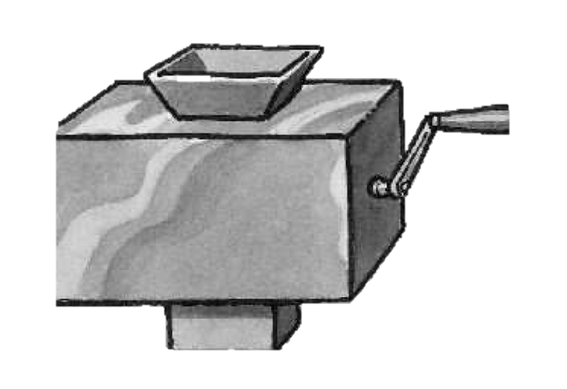
Domain and range
A function has allowed inputs and possible outputs.
Domain
Range
Allowed inputs.
Example: a score from 0 to 100.
Possible outputs.
Example: pass, review, or retry.
A function machine: input goes in, output comes out
Types are one way to make domain and range visible in code.
L02 | Expressions, Values, and Types
XL Academy x Aetheras.io

Slide 10
Same value, different representations
A value is the idea. A representation is how we write it.
One value
Many representations
Programming habit
The idea: four.
It can be written many ways.
4
"four"
0b100
IV
Know which representation you have.
Convert only when the program needs it.
This is why types matter: the same-looking symbol can mean different things in different contexts.
L02 | Expressions, Values, and Types
XL Academy x Aetheras.io

Slide 11
Type errors are design feedback
A type error is not a personal failure. It is a message about a mismatch.
const total = 40 + "8";
// What did we mean?
// 48 or "408"?
Ask three questions
What value do I have?
What type is it?
What type do I need?
Fix the idea first
Do not silence the error.
Clarify the intended value.
Then change the code.
L02 | Expressions, Values, and Types
XL Academy x Aetheras.io

Slide 12
AI can help you practice tracing
Use AI to make examples. Do not outsource the thinking.
Good prompt
Your job
Give me three TypeScript expressions.
Show each evaluation step.
Include the type of each final value.
Check every step.
Run the code yourself.
Explain why the type makes sense.
Generated code is a draft until you can trace it.
L02 | Expressions, Values, and Types
XL Academy x Aetheras.io

Slide 13
Studio build: score summary
Build one tiny program that turns raw values into a useful result.
type Result = "pass" | "review";
const summarize = (score: number): Result =>
score >= 70 ? "pass" : "review";
Build steps
Trace scores 90, 70, and 69.
If setup is green, add code and test.
If yellow/red, save the value table and exact error.
Discuss
What is the input type?
What is the output type?
What assumption did the code make?
L02 | Expressions, Values, and Types
XL Academy x Aetheras.io

Slide 14
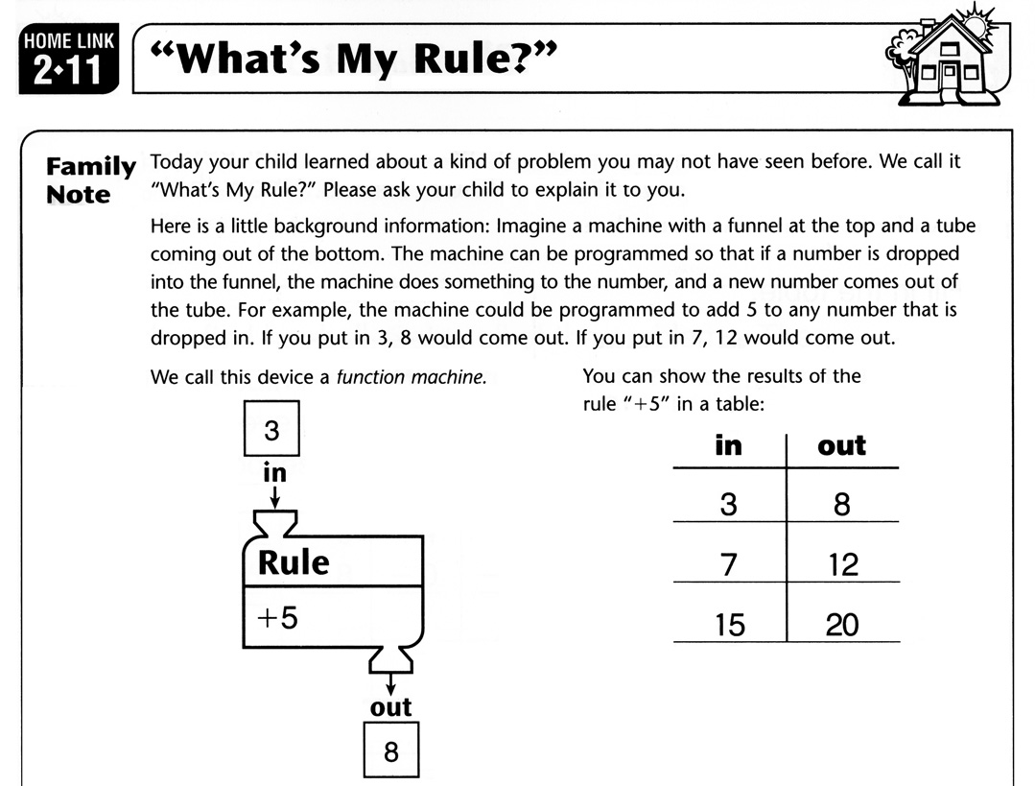
Activity: find the rule
Look at input-output pairs and infer the hidden expression.
Your turn
Pick three input-output pairs.
Guess the expression.
Test a new input.
Source visual: infer the rule from examples
This is the same habit you use when reading unfamiliar code: infer the rule, then test it.
L02 | Expressions, Values, and Types
XL Academy x Aetheras.io

Slide 15
Programming is revision
A good trace makes the next edit obvious.
Predict
Trace
Run
Revise
what value?
which steps?
what happened?
what changed?
What good programmers do
Work in small changes.
Use errors as clues.
Explain the value and type.
L02 | Expressions, Values, and Types
XL Academy x Aetheras.io

Slide 16
Lab plan: practice, build, apply
Use the main lab block to turn the concept into working evidence.
Guided practice
Build target
Project time
Evaluate expressions by hand before running them.
Predict the type of each value.
Find one assumption hidden in a variable name.
Make a score summary from constants and expressions.
Add labels that explain the result.
Define the first P1 values: score, lives, level, or turn.
Write the expected type for each value.
P1: Game Rules Milestone
L03-L15
L02 | Lab
XL Academy x Aetheras.io

Slide 17
Bonus activities
Choose one if the main lab is solid and tested.
Stretch options
Done when
Add a formatted message.
Find a case where a string and number mix incorrectly.
Ask AI for five test values and reject weak ones.
The main lab still works.
You can explain the tradeoff or edge case.
You saved one proof object: test, trace, screenshot, or note.
P1: Game Rules Milestone
L03-L15
L02 | Lab extensions
XL Academy x Aetheras.io

Slide 18
Checkpoint
Move on when you can explain the value, type, and assumption.
Exit ticket
Next class preview
One expression I can trace.
One value and its type.
One type error I can explain.
One AI answer I would verify.
Functions as abstractions.
Parameters and return values.
Contracts we can test.
L02 | Expressions, Values, and Types
XL Academy x Aetheras.io

