Slide 1
L01
AI Game Development & Computer Science Summer Program
Lecture 1: Computing, Abstraction, and Programming
L01 | Computing, Abstraction, and Programming
XL Academy x Aetheras.io
Notes:
Agenda:
- Explain abstraction: hide detail, keep the idea.
- Trace input through a function.
- Use AI as a draft, then verify.
Goals:
- A setup status: green, yellow, or red.
- A tiny interaction plan.
- One AI suggestion we would verify.

Slide 2
Today's agenda
Use this to track the plan and goals for the session.
Agenda
Goals
Explain abstraction: hide detail, keep the idea.
Trace input through a function.
Use AI as a draft, then verify.
A setup status: green, yellow, or red.
A tiny interaction plan.
One AI suggestion we would verify.
L01 | Computing, Abstraction, and Programming
XL Academy x Aetheras.io

Slide 3
Today's path
One setup check, one durable computing idea, one tiny interaction plan.
1
Setup check
Green, yellow, or red tells us what help you need.
2
Computing is modeling
We choose what matters and leave the rest out.
3
Abstraction has two moves
Remove detail. Generalize a pattern.
4
AI helps, then we verify
Generated code is a draft until we inspect and test it.
5
Studio
Plan a tiny interaction; code only if setup is green.
L01 | Computing, Abstraction, and Programming
XL Academy x Aetheras.io

Slide 4
First-day setup check
Setup status is not a grade. It tells us how to help.
Green
Yellow
Red
`npm test` passes.
`npm run dev` opens the starter game.
You can start the optional code step.
One command failed.
You copied the exact error.
You can still do the paper plan.
You cannot open the folder or terminal.
Stop changing things.
Ask for setup clinic help.
Everyone can complete today's concept work even if setup is yellow or red.
L01 | Computing, Abstraction, and Programming
XL Academy x Aetheras.io

Slide 5
Course promise
We are learning how to build useful, responsible software.
Think clearly
Build visibly
Use AI responsibly
Name the idea.
Choose useful details.
Explain the model.
Use TypeScript.
Make small programs work.
Debug with evidence.
Ask better questions.
Check generated code.
Protect private data.
Class rhythm: explain briefly -> trace together -> build -> share.
L01 | Computing, Abstraction, and Programming
XL Academy x Aetheras.io

Slide 6
Source note
This lesson adapts selected public computing ideas for this course.
What is reused
How we adapt it
Abstraction as the first big idea.
Detail removal and generalization.
Interface, specification, and contract.
Examples are now programming and TypeScript based.
AI is treated as a tool with boundaries.
Projects target useful, responsible apps.
Source note: adapted from public computing course materials and rewritten for this program.
L01 | Computing, Abstraction, and Programming
XL Academy x Aetheras.io

Slide 7
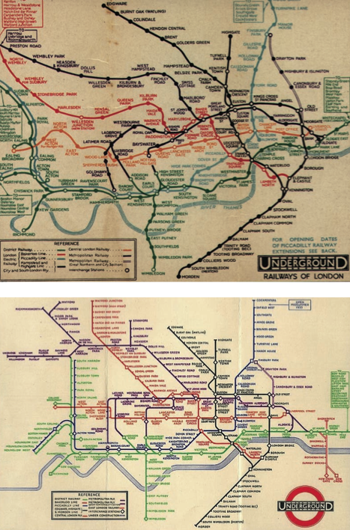

Abstraction is the first big move
An abstraction keeps what matters for the job and hides what does not.
Detail removal
Keep the useful details.
Hide what distracts from the task.
Generalization
Find the repeated pattern.
Turn it into one rule.
Detail removal in visual form
A map abstracts a city for one task
Your question: what did the map hide, and what did it keep?
L01 | Computing, Abstraction, and Programming
XL Academy x Aetheras.io

Slide 8
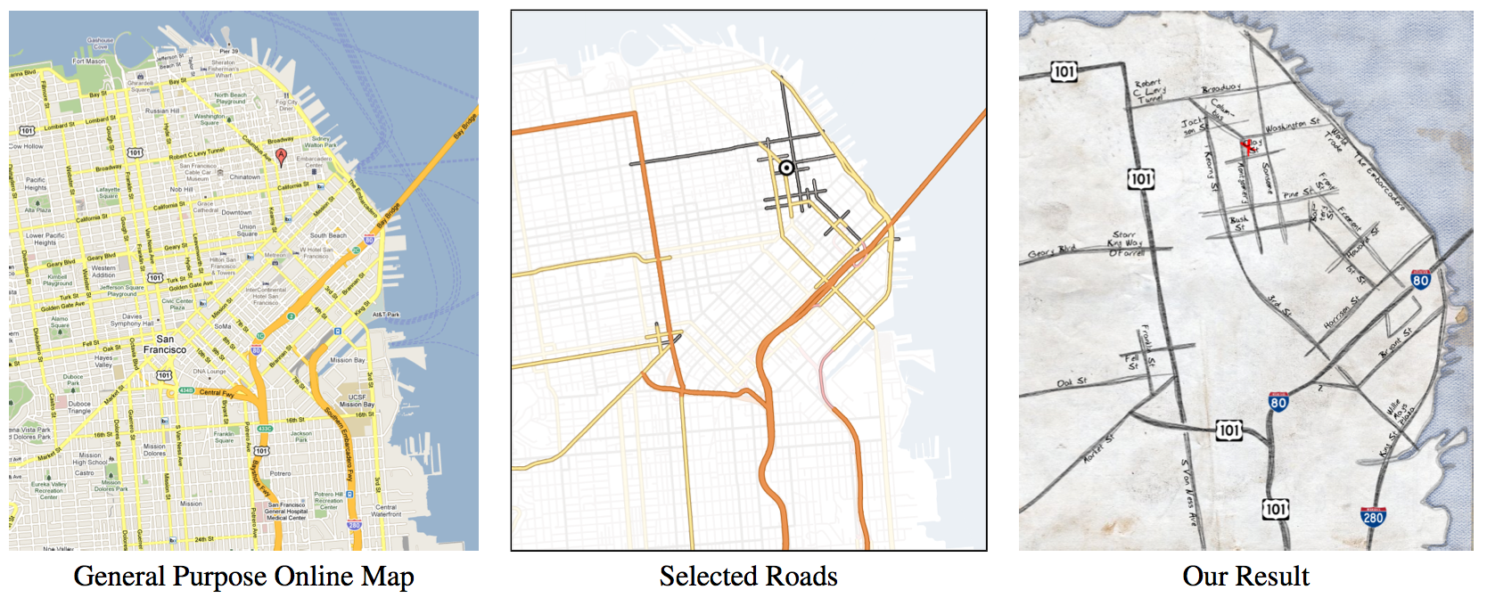
Detail removal: from messy world to buildable model
Programming starts by deciding what the program will ignore.
Real world
Buildable model
Visible app
People give different inputs.
Users type surprising input.
An input value.
A validated string.
A function returns a result.
A message explains what happened.
From full detail to the details needed for this task
A transit map optimizes for decisions, not geography
L01 | Computing, Abstraction, and Programming
XL Academy x Aetheras.io

Slide 9
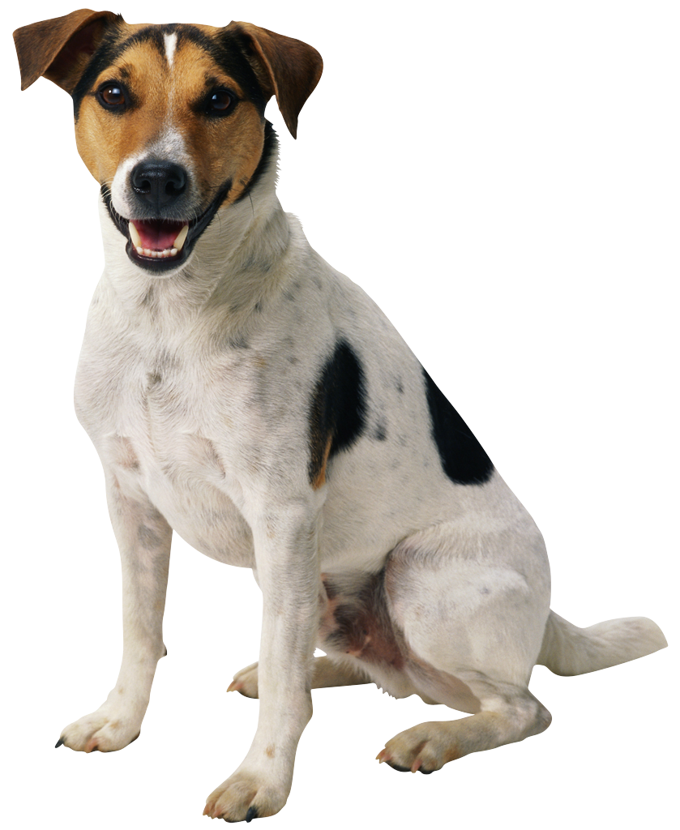
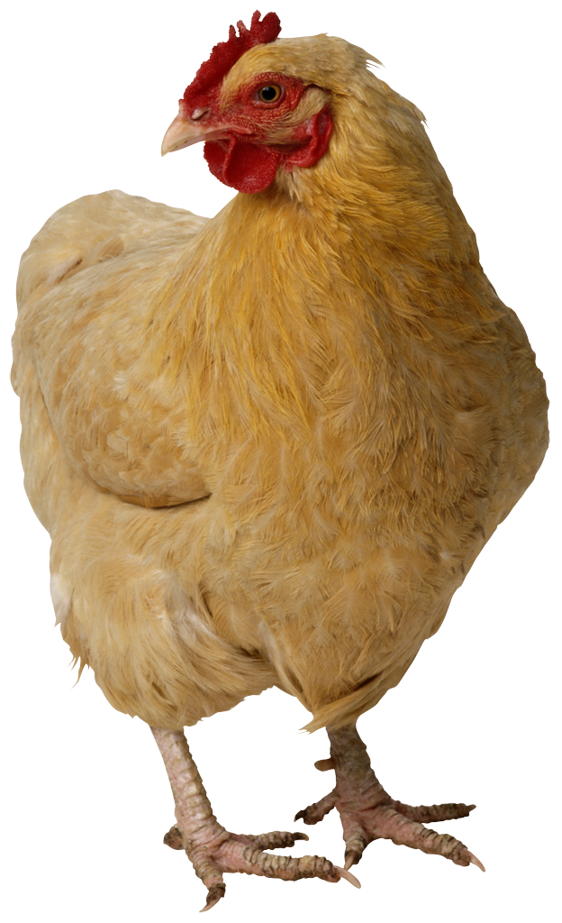
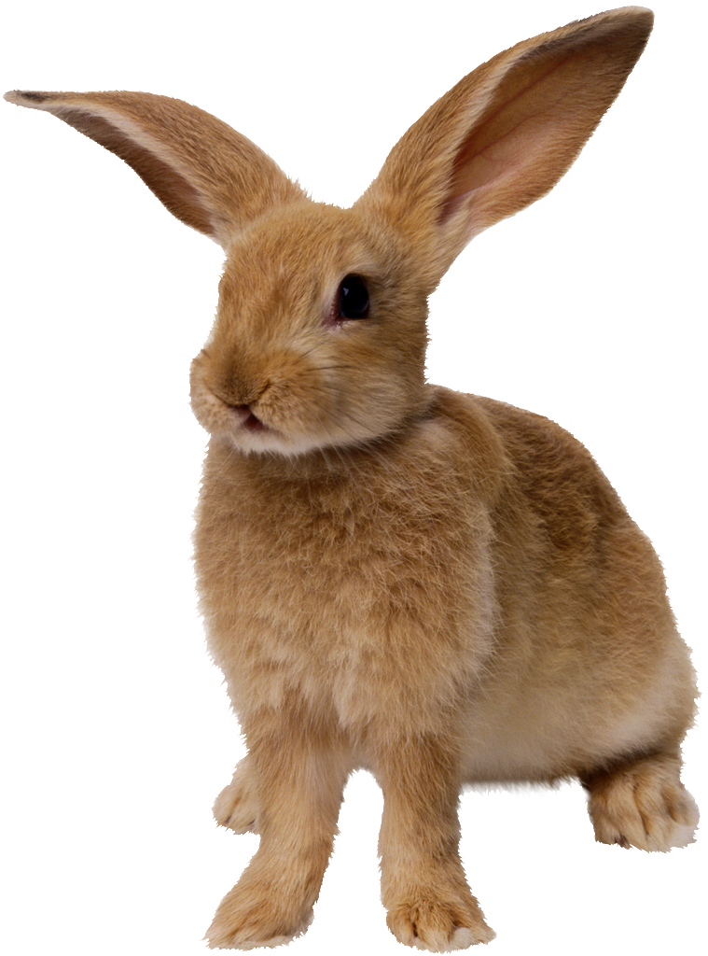
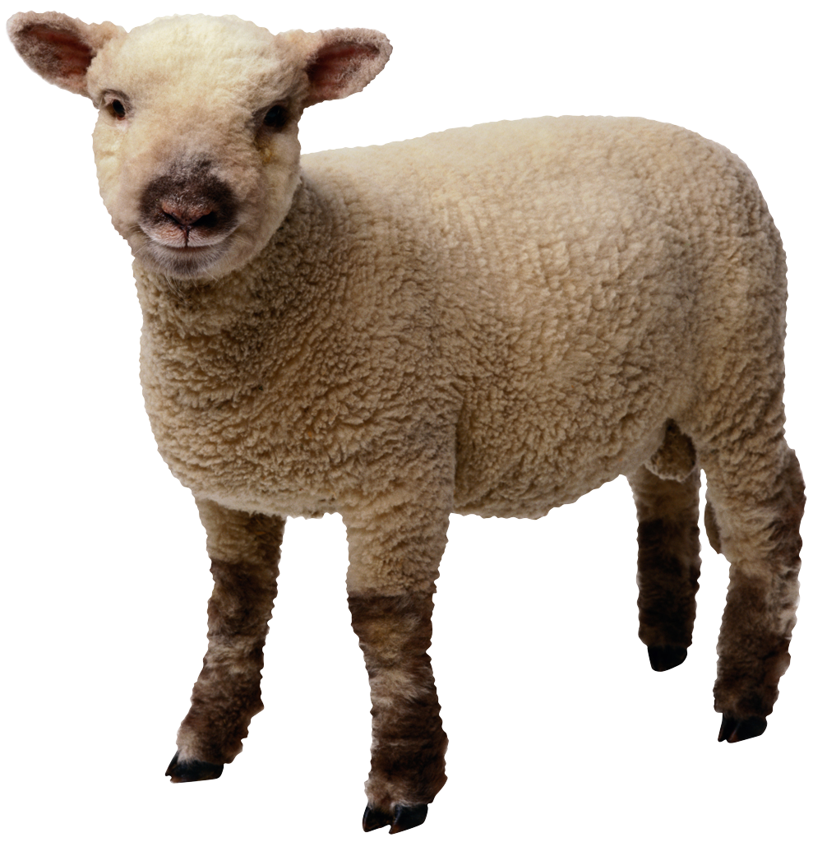
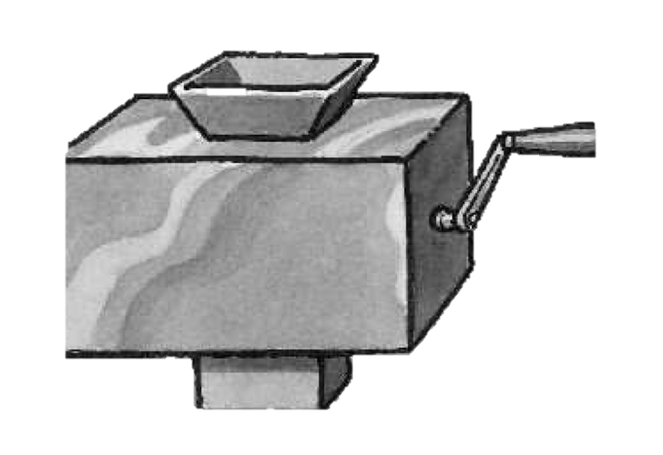
Generalization: one rule beats many copies
The goal is not shorter code. The goal is one clear idea that works for many cases.
// Repeated instructions
feedDog();
feedChicken();
feedRabbit();
// One generalized rule
type Animal = "dog" | "chicken" | "rabbit" | "sheep";
const feed = (animal: Animal) =>
`feed the ${animal}`;
dog
chicken
rabbit
sheep
same rule, new input
Why this matters
The parameter names what changes.
The type says which inputs make sense.
L01 | Computing, Abstraction, and Programming
XL Academy x Aetheras.io

Slide 10
Programs are abstraction stacks
You do not need every detail at once. You need the layers you can reason about.
Goal
Data
Function
Contract
Implementation
what we want
what we know
what changes
what is promised
hidden details
Abstraction barrier: use the promise first. Learn the hidden details when they matter.
L01 | Computing, Abstraction, and Programming
XL Academy x Aetheras.io

Slide 11

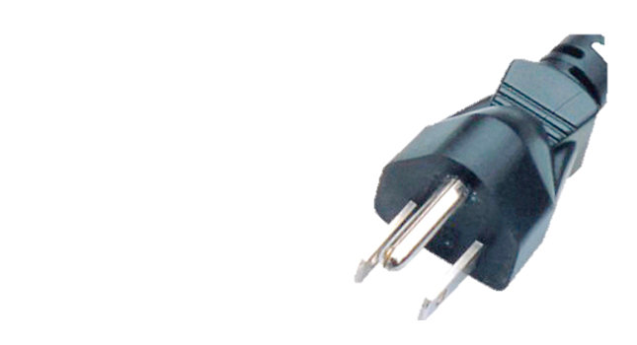

Interface, specification, contract
An abstraction is strongest when everyone knows what can be relied on.
Interface
Specification
Implementation
What the outside world can touch.
Examples: a function name, a parameter, a command.
What the interface guarantees.
Inputs, outputs, timing, errors, and edge cases.
How the promise is kept.
Details can change if the contract still holds.
const formatName = (name: string): string =>
name.trim() === "" ? "Anonymous" : name.trim();
interface
compatible input
translation layer
L01 | Computing, Abstraction, and Programming
XL Academy x Aetheras.io

Slide 12
First TypeScript trace: transform an input
Read the program as a path from input to output before changing it.
type Mood = "focused" | "stuck" | "curious";
const nextStep = (mood: Mood): string => {
if (mood === "stuck") return "ask a smaller question";
if (mood === "curious") return "try one experiment";
return "keep building";
};
Trace before run
What inputs are allowed?
Which branch runs?
What output comes back?
What input is impossible?
L01 | Computing, Abstraction, and Programming
XL Academy x Aetheras.io

Slide 13
The studio build
Leave class with a plan you can explain and code only if setup is green.
Required target
Pair roles
One input.
One rule.
One output.
One edge case.
Navigator explains the abstraction out loud.
Driver writes the plan or makes one small code check.
Switch after each visible result or decision.
Discuss
What did your function promise?
What input did your rule allow?
What is your setup status?
L01 | Computing, Abstraction, and Programming
XL Academy x Aetheras.io

Slide 14
AI is a tool, not an authority
AI can draft an explanation or code snippet. It cannot take responsibility for your program.
AI can help
You still own
Generate ideas and smaller examples.
Explain a confusing error message.
Suggest test cases or edge cases.
Compare two versions of a function.
Reading every line.
Checking inputs and outputs.
Running the code yourself.
Deciding whether the answer is appropriate.
First rule: generated code is a draft until it survives your types, your tests, and your explanation.
L01 | Computing, Abstraction, and Programming
XL Academy x Aetheras.io

Slide 15
Where AI fits in programming
AI may suggest code for one part while missing the whole idea.
Prompt
Draft code
Type check
Run code
Revise
Use AI for a small, specific boundary
Use TypeScript to make the draft checkable
Good: write a function that formats a username.
Better: include input type, output type, and two edge cases.
Best: ask for tests before asking for implementation.
Types expose vague assumptions.
Optional values force missing-element handling.
Small functions are easier to test and explain.
L01 | Computing, Abstraction, and Programming
XL Academy x Aetheras.io

Slide 16
AI collaboration boundaries
The boundary is simple: use help to learn and improve, not to bypass understanding.
Good use
Not good use
Explain this concept in a simpler way.
Give me three practice problems.
What does this error message mean?
Suggest edge cases I should test.
Build my whole project for me.
Write this function so I can submit it.
Paste private data or API keys.
Trust generated code without checking.
L01 | Computing, Abstraction, and Programming
XL Academy x Aetheras.io

Slide 17
Activity: AI as pair programmer
The goal is not to get perfect code. The goal is to practice inspection.
Prompt:
Ask AI for a TypeScript function that turns
a mood into a next step.
Improve one thing
Make the type clearer.
Move logic into a named function.
Add one testable edge case.
Rewrite the prompt more precisely.
In pairs, mark the assumptions
Which inputs does it allow?
What output does it promise?
What edge case is missing?
L01 | Computing, Abstraction, and Programming
XL Academy x Aetheras.io

Slide 18
Programming is revision
Good code is usually not first-draft code.
Try
Run
Test
Explain
Revise
make a small visible change
observe what actually happens
check the smallest meaningful unit
say the abstraction out loud
tighten the contract
What good programmers do
Treat bugs as information.
Explain the change.
Revise one small thing at a time.
L01 | Computing, Abstraction, and Programming
XL Academy x Aetheras.io

Slide 19
Lab plan: practice, build, apply
Use the main lab block to turn the concept into working evidence.
Guided practice
Build target
Project time
Locate `START_HERE.md`, the first-run checklist, the pair-work guide, the setup guide for your computer, and `starter/README.md`.
Run the tool checks for Git, Node.js, and npm.
Trace input, process, and output for the starter game and one everyday system.
Create a setup status note with evidence: green, yellow, or red.
Run the starter tests and browser app if setup is green; otherwise write the help-request note.
Draft a two-sentence rule contract: input, rule, output, and one edge case.
Use `projects/templates/project-choice-card.md` to choose a simple game mechanic for P1.
List the values the mechanic needs.
Write one setup or coding question to bring to the next class if anything is unclear.
P1: Game Rules Milestone
L03-L15
L01 | Lab
XL Academy x Aetheras.io

Slide 20
Bonus activities
Choose one if the main lab is solid and tested.
Stretch options
Done when
Save the passing `npm test` result or the exact setup blocker as a proof object.
Find where the starter game rule lives in `starter/src/game.ts`.
Ask AI for a second mechanic, then simplify it before writing code.
The main lab still works.
You can explain the tradeoff or edge case.
You saved one proof object: test, trace, screenshot, or note.
P1: Game Rules Milestone
L03-L15
L01 | Lab extensions
XL Academy x Aetheras.io

Slide 21

Checkpoint
Move on only when the core abstraction is explainable without syntax.
Exit ticket
Next class preview
One abstraction I can explain.
My setup status: green, yellow, or red.
One input, rule, output, and edge case.
One AI suggestion I would verify before trusting.
Expressions, values, and types.
How programs store and transform values.
How type errors become design feedback.
A stable interface hides changing implementation
L01 | Computing, Abstraction, and Programming
XL Academy x Aetheras.io

